Slide 1
Questionnaire
Issues with FLIP Questionnaire
Screening Questions
Excludes non-finance majors; limits insights.
Doesn't capture those uncertain about certifications.
Response Scale Problems
No “Not Applicable” (N/A) option for some questions.
Frequency-based questions (Q7-Q9) need clearer numerical scales.
Lack of Open-ended Questions
No space for respondents to explain their preferences or motivations.
Recommendations
Revise screening questions to include a broader audience.
Improve response scales by adding N/A options and quantifying frequency-based questions.
Convert the scales to a more quantitative scale (e.g., "0 times," "1-2 times," "3-5 times," "More than 5 times")
Add open-ended questions like “What factors influence your decision to pursue a financial certification?” for richer insights.

Slide 2
Issue- D7 (Ranking in Class) forces students into limited ranking categories (Top 10%, Top 25%, Neither), which may discourage honest responses.
Recommendation- Instead of ranking in class, ask:
How would you describe your academic performance? (Top 10%, Top 25%, Middle 50%, Lower 25%)
What is your current year of study? (First Year, Second Year, Final Year, Alumni)
Issue- Q5 (Convenience of test preparation) is vague—students might consider different factors (time, ease of content, flexibility)., Q6 (Price sensitivity) asks if they care about cost, but does not measure willingness to pay.
Recommendation- Break down "convenience" into specific aspects: Time flexibility, difficulty level, study materials.
Instead of "I care about cost", ask:
What is the maximum amount you are willing to pay for a certification? (INR 1000–2000, 2000–3000, etc.)

Slide 3

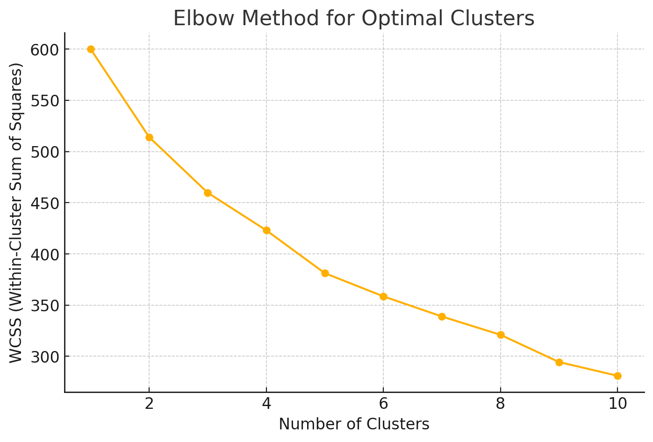
Cluster 0: Experienced and Practical Learners
Considerable work experience (average 18.2 yeLower price sensitivity, indicating a willingness to invest in certifications.
Moderate interest in campus placement opportunities.
Strong emphasis on practical knowledge and job transitions.
Balanced sensitivity to pricing and convenience.
Moderate participation in career counseling and finance workshops
Cluster Analysis
Cluster 1: Career-Driven and Ambitious Professionals
Mid-level work experience (~19 years).
Strong preference for campus placements and career guidance.
High adaptability to e-learning (average comfort level: 3.9).
Lower price sensitivity, indicating a willingness to invest in certifications.
Cluster 2 : Emerging Graduates and Knowledge Enthusiasts
Minimal work experience (~2.7 years).
Heavy reliance on campus placements for career opportunities.
Lower inclination toward job-switching.
Moderate interest in career counseling and financial literacy workshops.

Slide 4
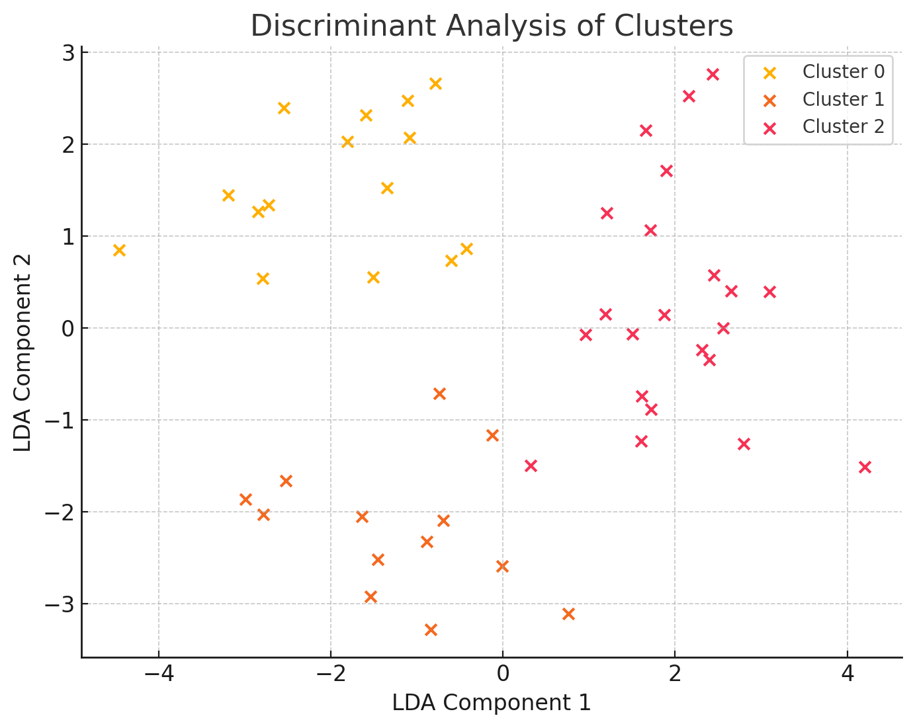
Cluster 0: Experienced and Practical Learners
Extensive work experience (~18 years) with moderate dependence on campus placements.
Strong preference for practical insights and career transitions.
Actively participates in finance workshops but places less emphasis on career counseling.
Moderate adoption of e-learning.
Segment
Interpretation
Cluster 1: Career-Driven and Ambitious Professionals
Mid-level experience (~19 years) with a strong focus on career placements.
Highly motivated to switch jobs and keen on practical learning.
Low sensitivity to pricing, showing a willingness to invest in career advancement.
Comfortable with e-learning and actively engaged in career counseling.
Cluster 2 : Emerging Graduates and Knowledge Enthusiasts
Minimal work experience (~2.7 years), heavily dependent on campus placements.
Less inclined toward job-switching but eager to expand financial knowledge.
Engaged in career counseling but somewhat price-conscious.
Open to e-learning but not as confident as Cluster 1.

Slide 5
Recommendations
Focus Area | Action plan
Target the Right Students | - Partner with career counseling & placement cells (Placement-focused) - Market advanced BFS courses (Skill-oriented) - Offer introductory bundles & free trials (General learners)
Competitive Positioning | - Highlight 7+ endorsing BFS partners for credibility - Promote faculty support & hands-on training (better than NCFM/CFA) - Provide discounted certification bundles
Marketing & Engagement | - Conduct seminars & webinars at business schools - Create a student referral & ambassador program - Partner with BFS companies for pre-hiring training
Digital Growth | - Run Google Ads & LinkedIn marketing to reach students - Offer freemium course trials - Launch an AI tool for personalized career guidance
Pricing & Payment Options | - Offer lower prices for students, premium for professionals - Introduce EMI & subscription models for affordability

